Slide 1

AMAZON SALES
PRESENTATION

Slide 2
Introduction
Amazon.com is an American multinational technology company, engaged in e-commerce, cloud computing, online advertising, digital streaming, and artificial intelligence.
But recently the company has witnessed a decline in its sales. This presentation deals with the important KPIs that we need to understand in order to recognize and solve this problem.

Slide 3
Main KPIs
Yearly Sales Trend
Monthly Sales Trend
Country map showcasing sales
Item wise sales
Item wise profit
Sales Channel wise Sales

Slide 4
Mock-Up Dashboard
Country wise sales
Yearly Sales
Monthly Sales
Item wise sales
Item wise profit
Sales Channel wise Sales

Slide 5
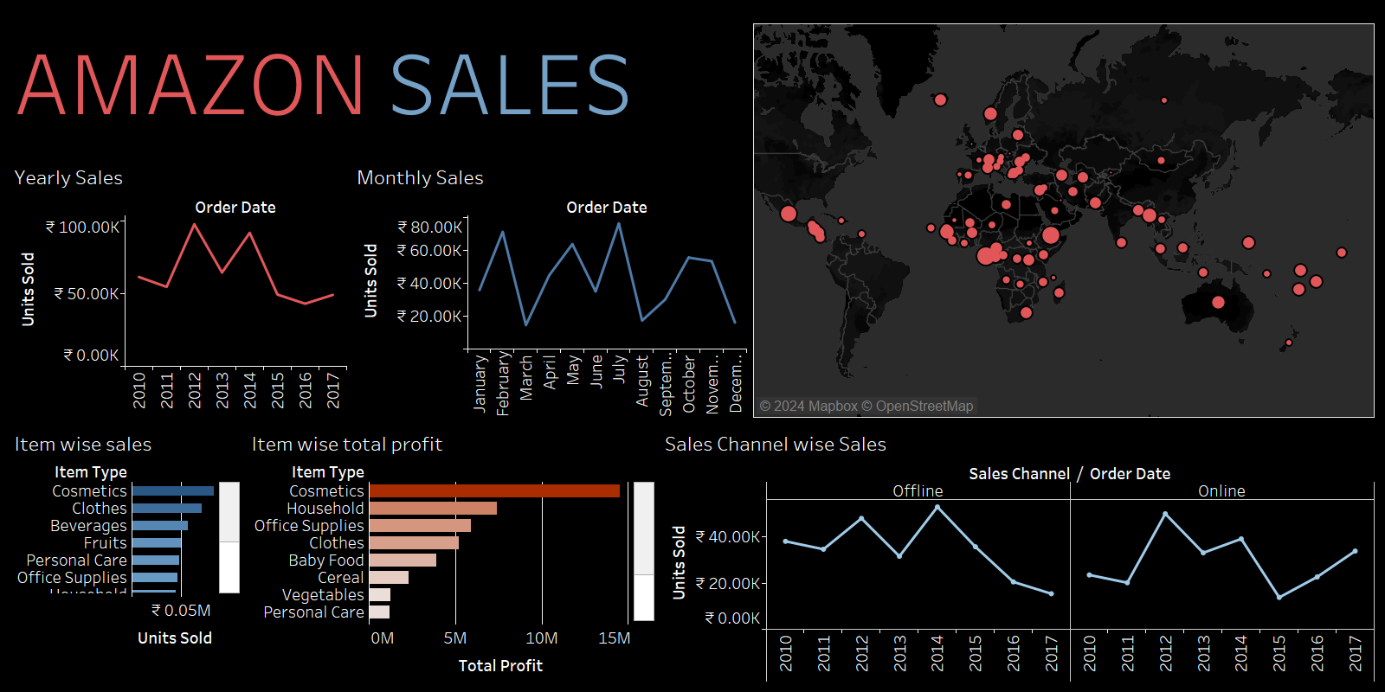

Slide 6
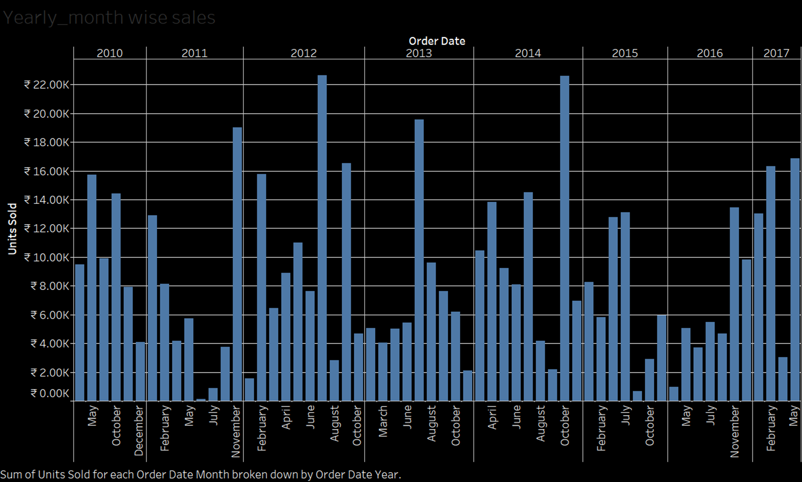
Yearly-month wise sales

Slide 7
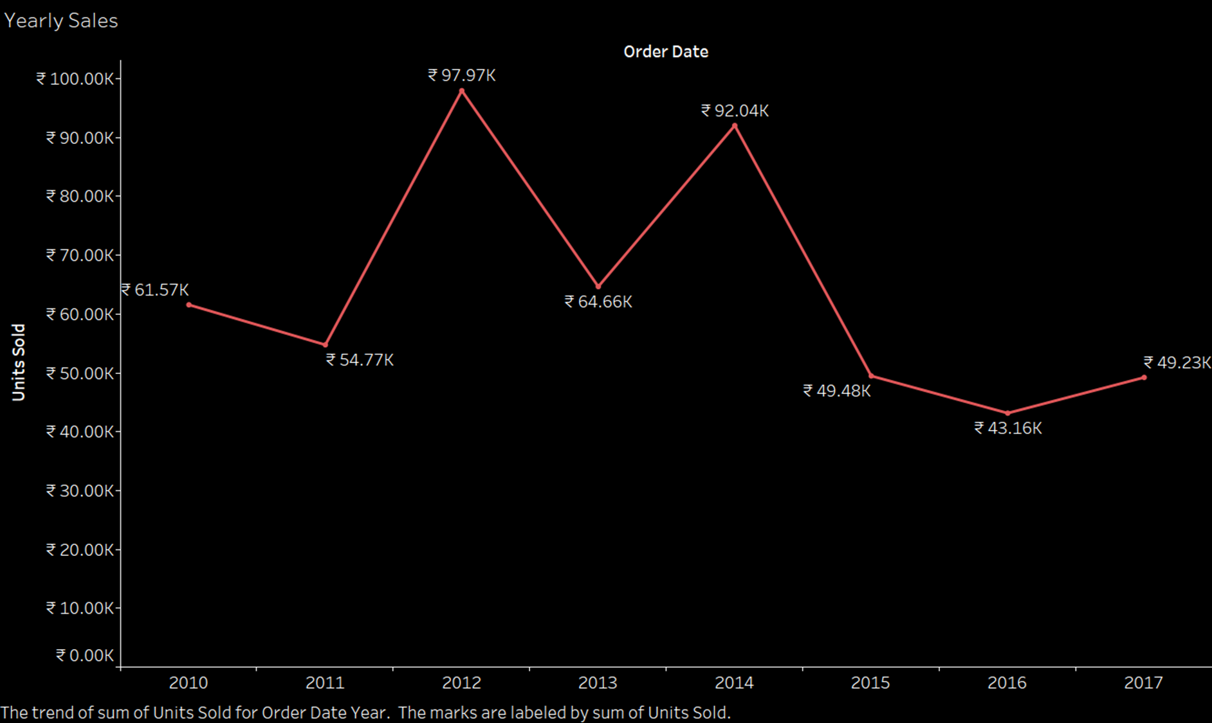
Yearly Sales There has been a decline in overall yearly sales in the past 3 years. Although the sales have improved in 2017 as compared to 2016 but still the increase is significantly low.

Slide 8
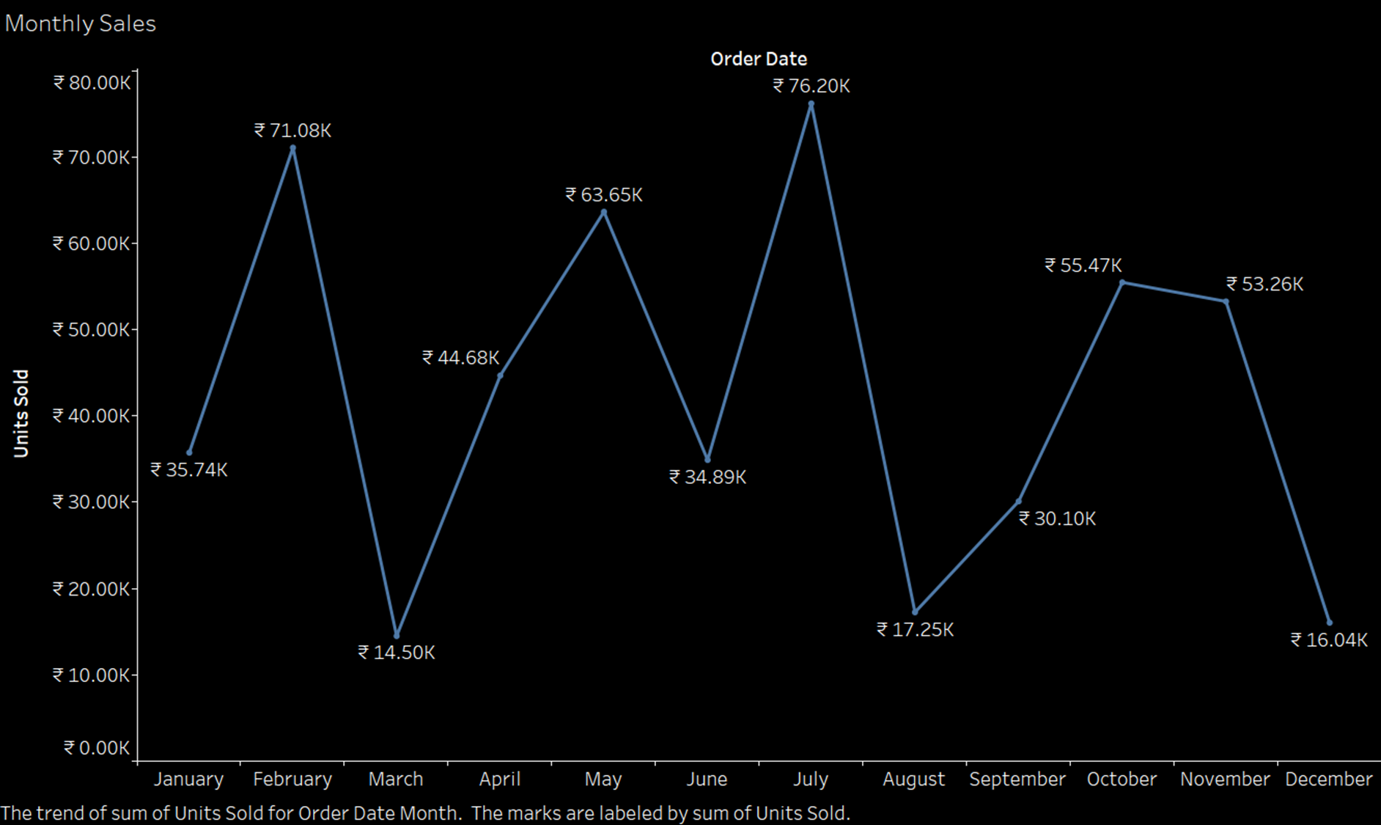
Monthly Sales Maximum sale month- July Minimum sale month- December

Slide 9
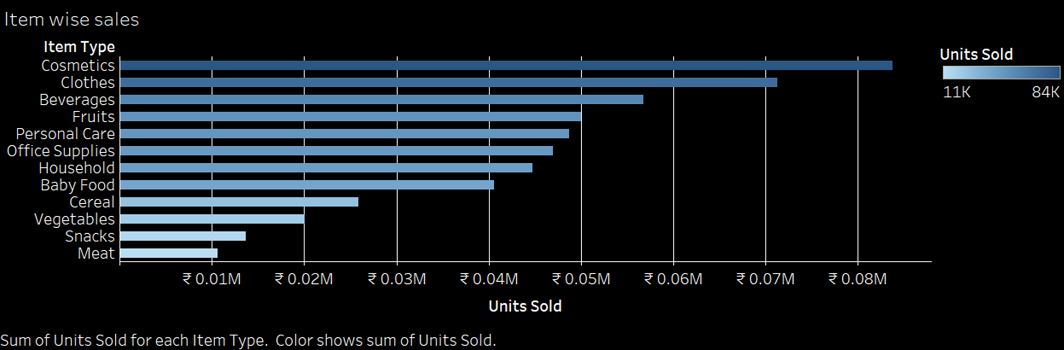
Item wise Sales Highest- Cosmetics Lowest - Meat

Slide 10
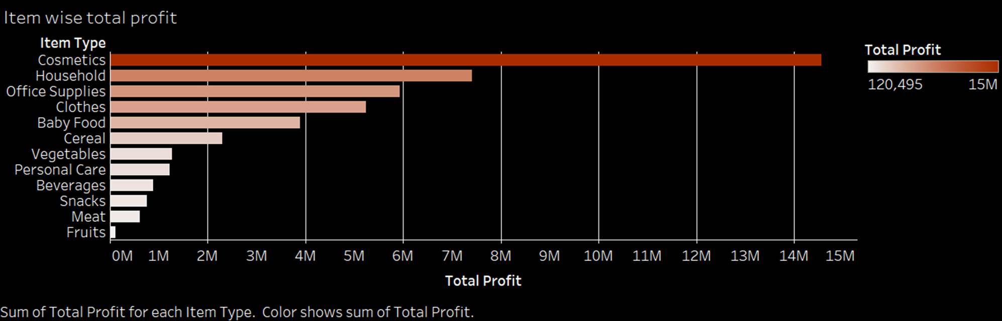
Item wise total profit Highest – Cosmetics Lowest - Fruits

Slide 11
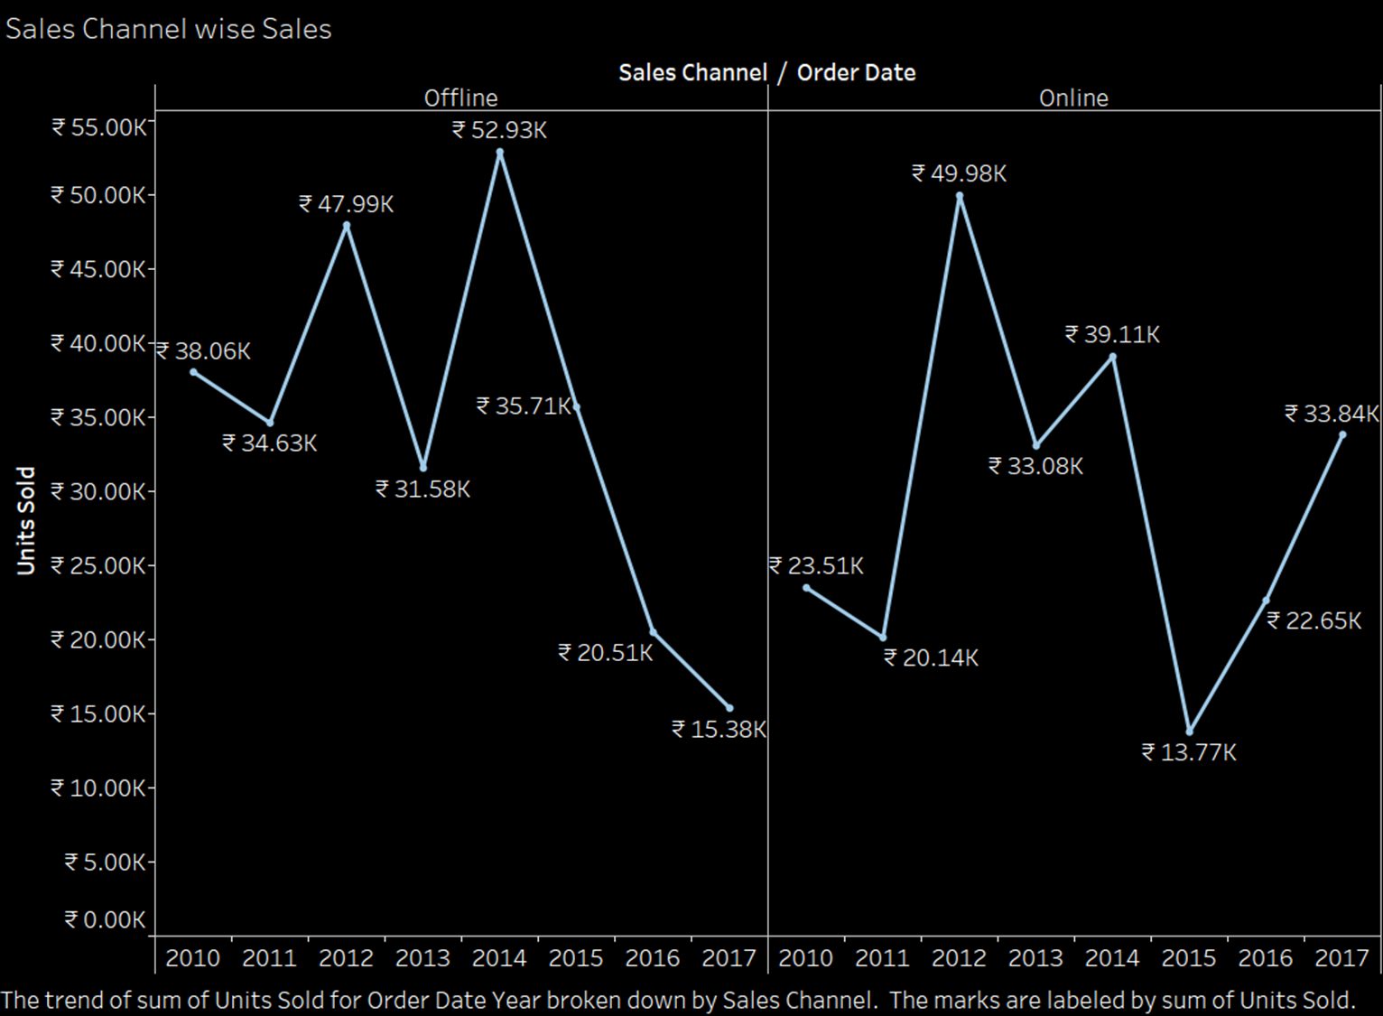
Sales Channel wise Sales As per the data, there has been a major decline in the offline sales which has caused the overall decline in the sales.

Slide 12
Conclusion
There has been a steep decline in the offline sales which has caused the overall sales in the past 3 years to decline.

Slide 13
THANKYOU

